Slide 1
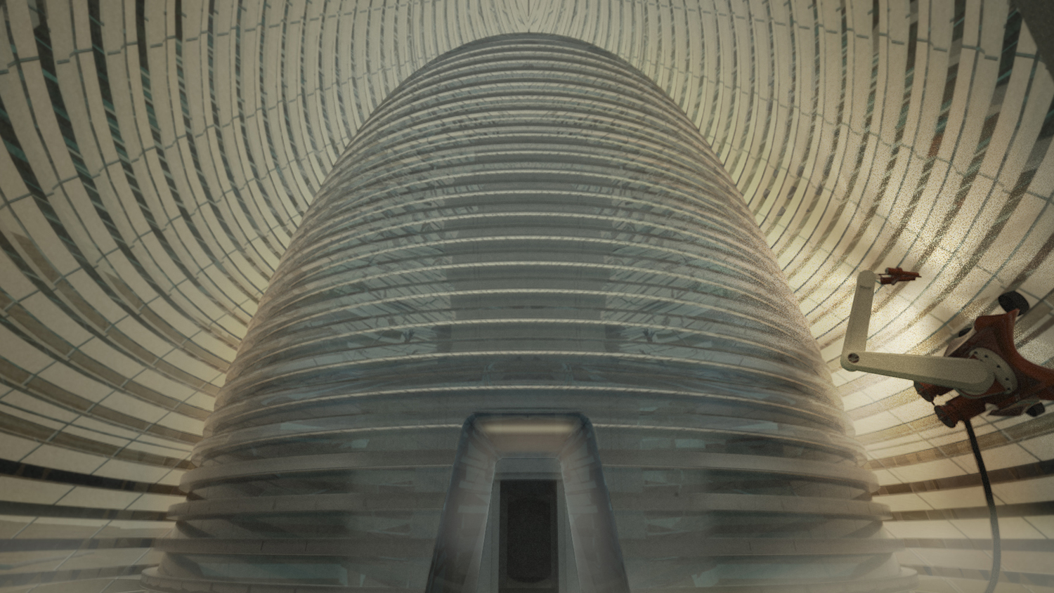
A study on the viability of ISRU techniques for the Moon and Mars
David Estébanez Mérida Diego Mataix Caballero

Slide 2




Index
1. Introduction
ISRU vs Materials brought from Earth
3. Martian architecture Materials, Manufacturing & Construction
2. Lunar architecture Materials, Manufacturing & Construction
4. Conclusions

Slide 3
ISRU vs Materials brought from Earth
Lunar and Martian regolith
Basalt
In-Situ Resource Utilization (ISRU)
Volcanic ash
Local ethylene
Water and carbon dioxide
Expendable materials from the used spacecraft
Materials brought from Earth
Deployable Metal Structures
Inflatable Structures

Slide 4
The solution: A trade-off between both solutions
+
In-Situ Resource Utilization
Materials brought from Earth
=
The possibility of Lunar and Martian outposts

Slide 5
Stages in the development of space colonies
Large-scale building structures comprised substantially of indigenous materials
Prefabricated and pre-outfitted hard-shell modules
Assembly of components fabricated on the Earth
CLASS I
CLASS II
CLASS III
Inflatable or deployable structures
Additive manufacturing
Casting
[7]
Notes:
Source paper: Additive manufacturing for a moon village

Slide 6


Lunar Architecture

Slide 7







Available Materials
Lunar Regolith
$$O_{2}$$
$$Si$$
$$Al$$
$$Ca$$
$$Fe$$
$$Mg$$
$$Ti$$
[2]
Notes:
Source paper: Indigenous Materials for Lunar Construction

Slide 8
Overview of reported use of regolith
Method | Subprocess | Material | Year
AM | Binder jetting | Regolith (unknown conc.), Sorel cement, binder liquid | 2014
AM | Extrusion | Regolith (72 wt.%), urea, alkaline solution | 2020
AM | Extrusion | Regolith (56 wt.%), phosphoric acid, water | 2018
AM | Extrusion | Regolith (74 wt.%), PLGA, DCM, plasticizer | 2017
AM | Extrusion | Regolith (70 wt.%), PLGA, DCM, plasticizer | 2017
AM | Laser melting | Regolith | 2020
AM | Laser melting | Regolith | 2016
AM | Laser sintering | Regolith | 2019
AM | Laser sintering | Regolith | 2016
AM | Laser sintering | Regolith | 2015
AM | Laser sintering | Regolith | 2012
AM | Microwave sintering | Regolith | 2013
AM | Solar sintering | Regolith | 2018
Casting | Geopolymer | Regolith (76 wt.%), liquid silicate, alkaline solution | 2015
Casting | Sulphur concrete | Regolith (65 wt.%), sulphur | 2012
Casting | Thermite reaction | Regolith (67 wt.%), aluminium powder | 2010
[9]
Notes:
Source paper: Additive manufacturing of lunar regolith simulant using direct ink writing

Slide 9
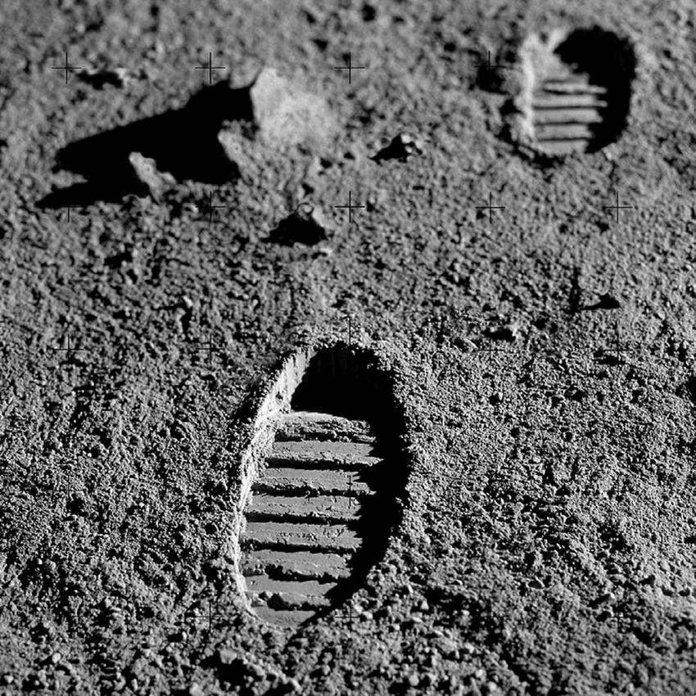
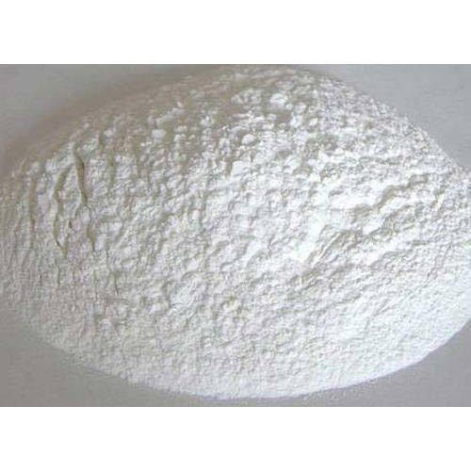

Additive Manufacturing – Sintering
Indigenous soil material (Regolith)
SINTERING
Heating of a porous material up to a particular temperature (below the melting point) which allows its particles to bond together with a concurrent decreasing of their porosity.
Low melting point binding agent (optional)
Potential fabrication methods for Lunar construction
Fused Deposition Modeling (FDM)
Selective Laser
(or Solar or Microwave) Sintering
[5]
Notes:
Source paper: A review towards the design of extraterrestrial structures: From regolith to human outposts
The most effective AM fabrication method in extraterrestrial environments is based on sintering the local materials.
Sintering is the heating of a porous material up to a particular temperature (below the melting point) which allows its particles to bond together with a concurrent decreasing of their porosity.
It has been stated that AM methods, including Fused Deposition Modeling (FDM) and Selective Laser (or Solar or Microwave) Sintering, can be used as potential fabrication methods for Lunar construction.

Slide 10
Additive Manufacturing – Sintering
A motivation:
To achieve densification and to improve the mechanical properties of the sample.
Three properties to take into account:
Size
Shape
Packing
And two main challenges:
Behaviour of materials in microgravity
Heterogeneus nature of regolith material
[9]
Notes:
Source paper: Additive manufacturing of lunar regolith simulant using direct ink writing

Slide 11
Additive Manufacturing – Binder jetting
D-Shape technology
The D-shape binding chemistry exploits two inorganic reactants:
MgO: Metallic oxide
MgCl₂: Magnesium Chloride
When the two reactants are mixed together, an exothermic chemical reaction occurs generating a reticulating process.
Regolith
Binder
[8]
Notes:
Source paper: Building components for an outpost on the Lunar soil by means of a novel 3D printing technology

Slide 12
Casting
Sulphur concrete
Thermite reaction
65 wt% regolith simulant
JSC-1
35 wt% sulphur (purified sulphur and silica sulphur)
Compressive strength
31 MPa
67 wt% regolith simulant
JSC-1AF/JSC-1A
33 wt% aluminium
Compressive strength
18 MPa
[4], [10]
Notes:
Source papers: Performance of lunar sulfur concrete in lunar environments and
Demonstration of concept for fabrication of lunar physical assets utilizing lunar regolith simulant and a geothermite reaction

Slide 13
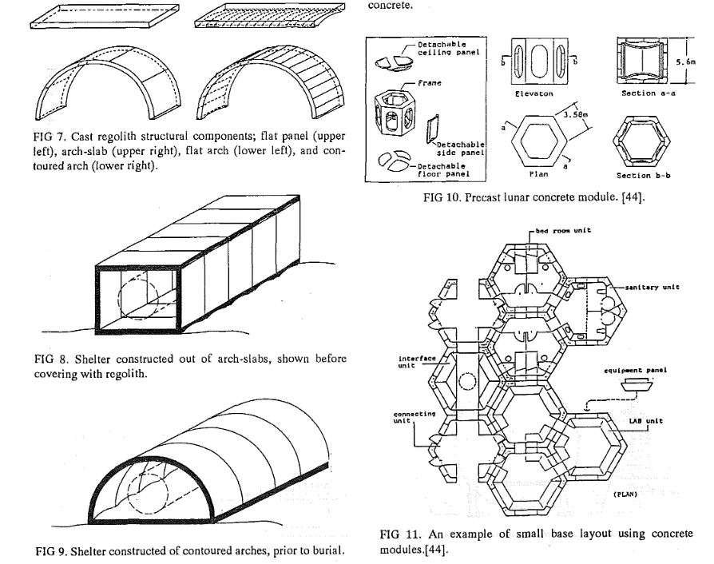

How would a Lunar skyline look like?
Modular Lunar Modules
Modular lunar modules can be built in a number of ways, for example:
Using shelter-type constructions: employing lunar regolith for radiation shielding
Using lunar concrete modules: employing ISRU manufacturing techniques
[2]

Slide 14
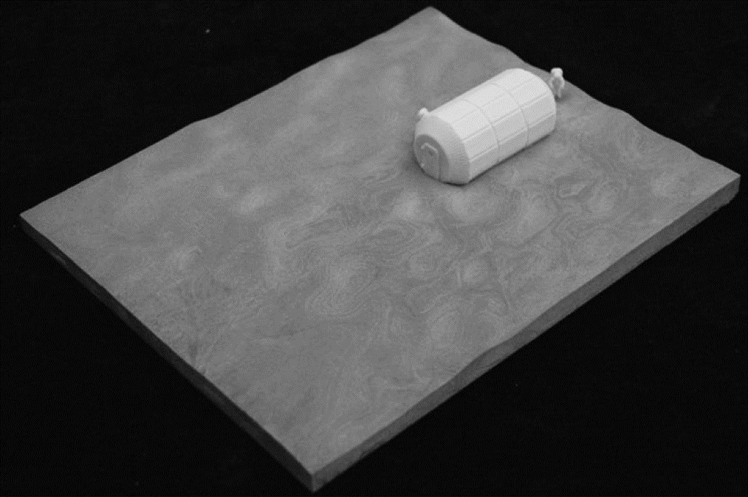
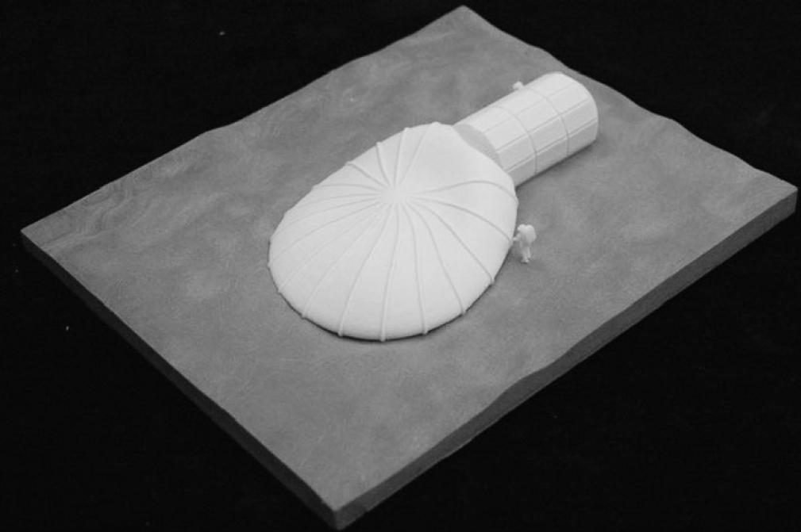
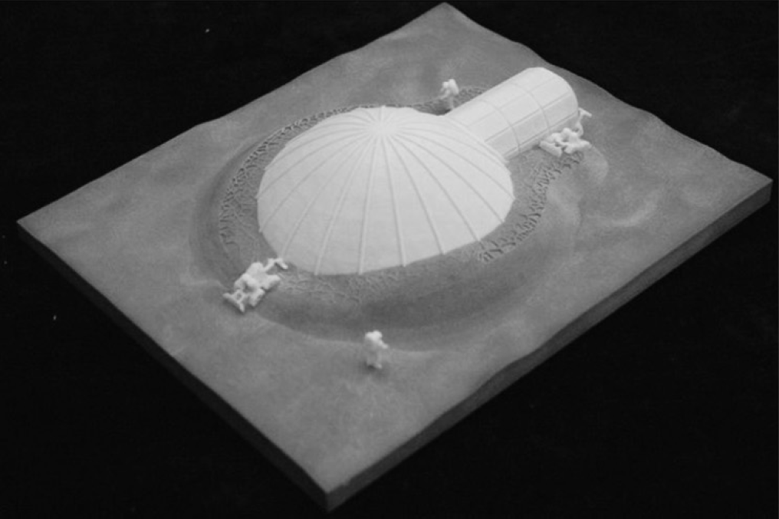
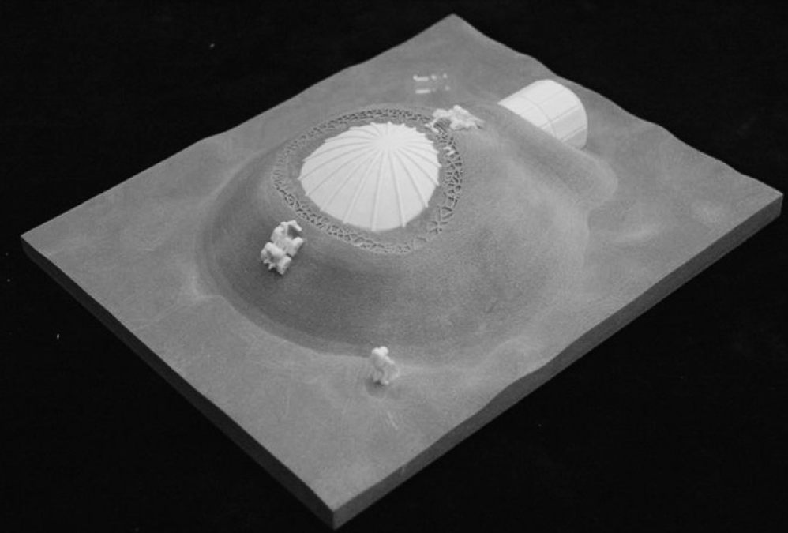
[8]
Notes:
Source paper: Building components for an outpost on the Lunar soil by means of a novel 3D printing technology

Slide 15
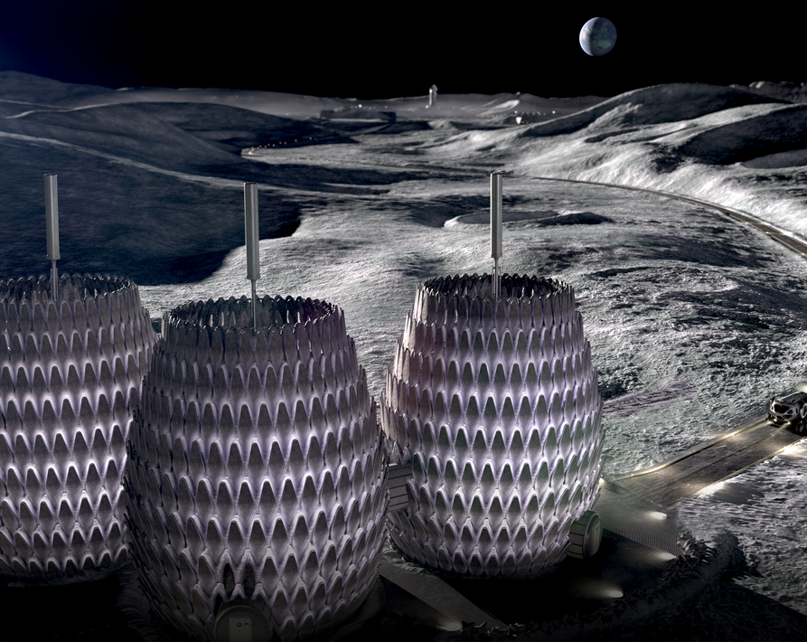
How would a Lunar skyline look like?
Future projects: Lunar Lantern (ICON’s Project Olympus)
Part of a proposal for a NASA-supported project to build a sustainable outpost on the moon.
The construction of this outpost leverages a number of burgeoning technologies as well as ISRU to minimize dependence on Earth, including the use of automated robotic 3D printers.
The main habitat employs three structural components: a Base Isolator, Tension Cables, and a Whipple Shield.
Notes:
Sources:
- http://www.spacexarch.com/lunar-lantern
- https://phys.org/news/2021-06-lunar-lantern-beacon-humanity-moon.html

Slide 16
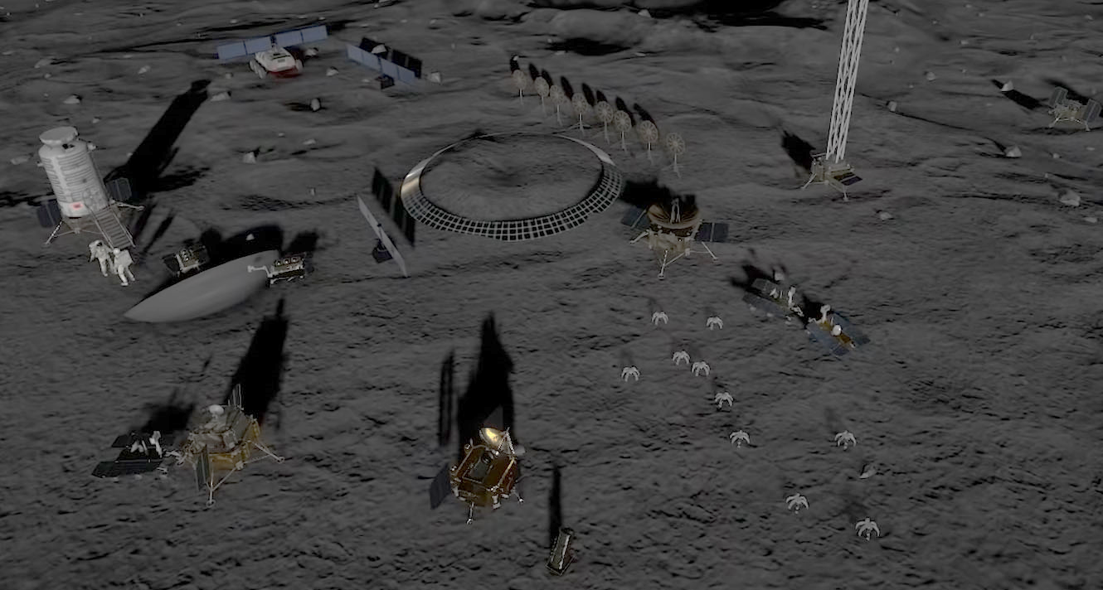
How would a Lunar skyline look like?
Future projects: Russian-Chinese Lunar base (Roscosmos + CNSA)
Roscosmos and the CNSA have proposed the construction of a collaborative project for the construction of a Lunar base by 2036.
This will use a combination of Earth materials and ISRU technologies.
Notes:
Sources:
- https://www.space.com/china-russia-international-lunar-research-station
- https://www.theguardian.com/science/2021/jun/25/russia-china-team-up-build-moon-base

Slide 17
Martian Architecture

Slide 18
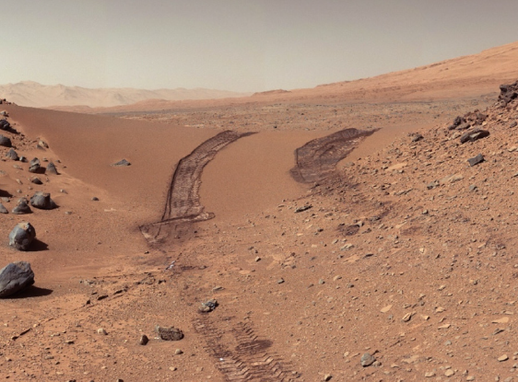
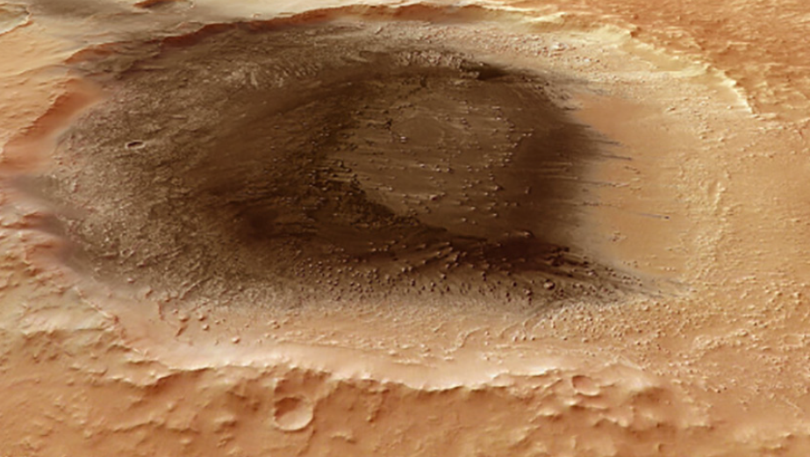
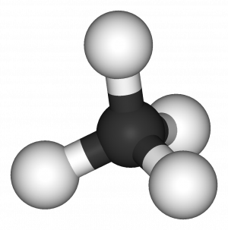
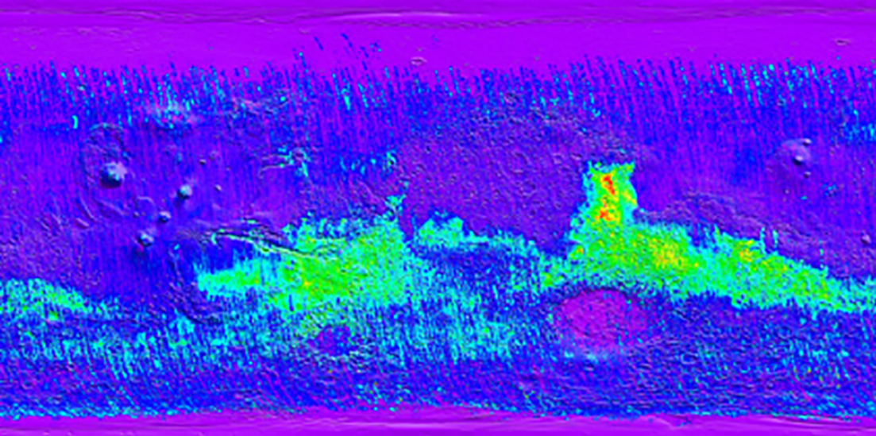
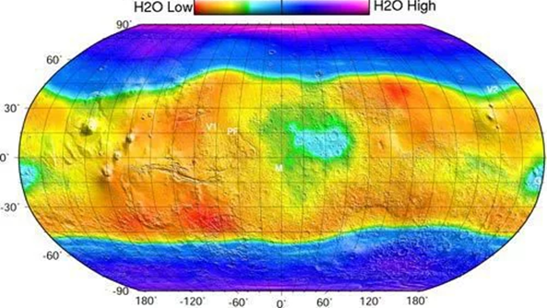
Available Materials
Martian Regolith
Volcanic Ash
Methane
Basalt
Ice Water
[1]
[3]

Slide 19
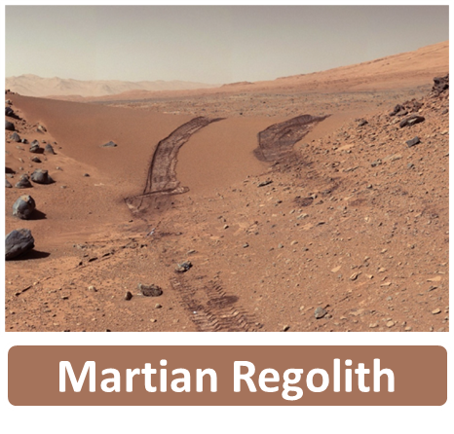

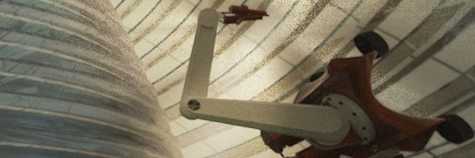
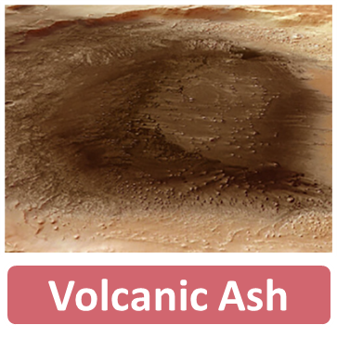
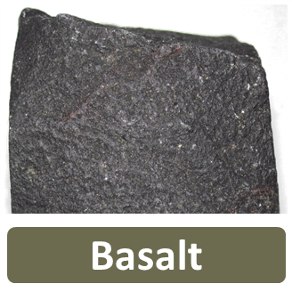

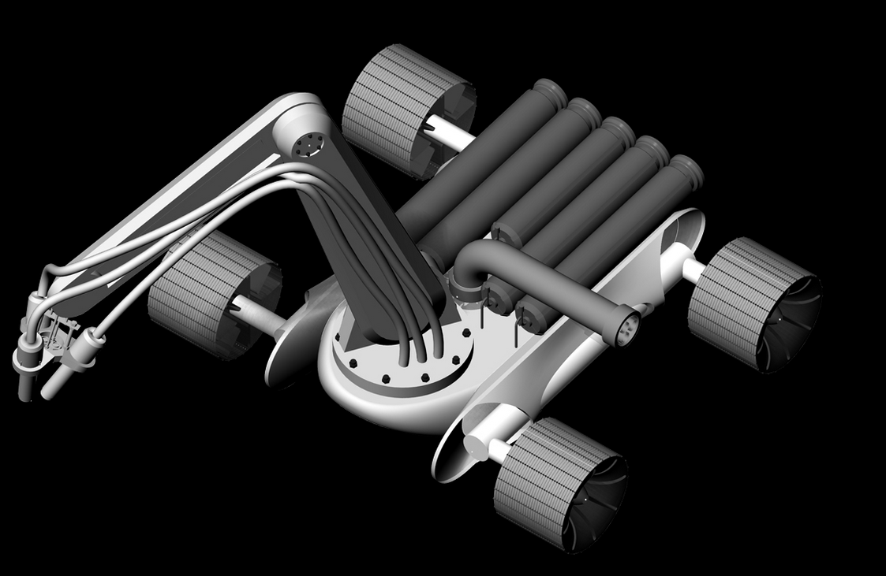
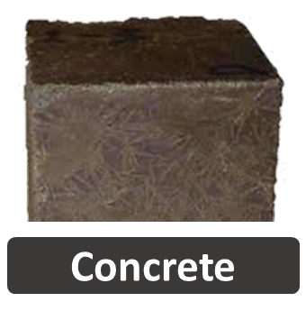


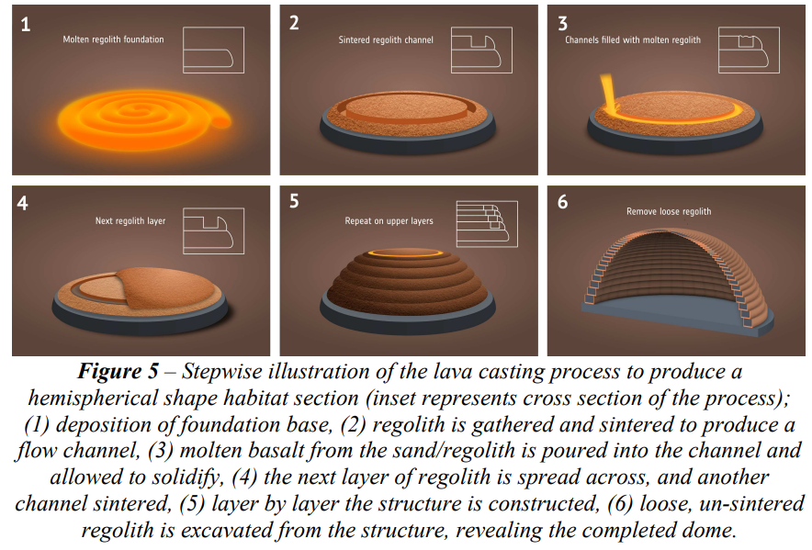
Manufacturing and Processing Methods
Processed & Raw Materials
Energy sources
Construction Methods
Solar Energy
Additive Manufacturing
Nuclear Energy
Intelligent Construction
Wind Energy
Lava Casting
[3]
Notes:
Source: In-situ resources for infrastructure construction on Mars: A review

Slide 20
Manufacturing and Processing Methods
Lava Casting
[6]
Notes:
Source: An ISRU-based architecture for Human Habitats on Mars; the 'Lava Hive' concept

Slide 21
Manufacturing and Processing Methods
Martian Concrete
Take into account
CONCRETE
+
Mixing and casting
Binder
Aggregate
Gravity
Air content
Fine bubbles
Curing
Low temperatures
[11]
Notes:
Source paper: Concrete on Mars: Options, challenges, and solutions for binder-based construction on the Red Planet

Slide 22
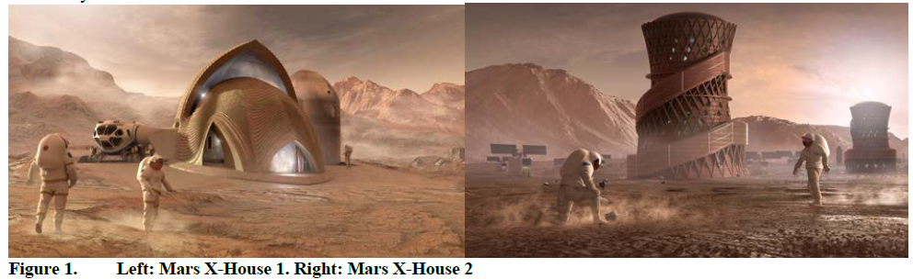
How would a Martian skyline look like?
Future projects: Mars X-House 1
Use of bulk surface material regolith as primarily a compressive material.
The 3D-printed regolith portion of the habitat was mainly conceived as radiation shield.
Two redundant inflatables brought from Earth constitute the habitable area.
[1]
Notes:
Source: Mars X-House: Design Principles for an Autonomously 3D- Printed ISRU Surface Habitat

Slide 23
How would a Martian skyline look like?
Future projects: Mars X-House 2
Based on the same environmental and architectural principle as Mars X-House 1, however, the 3D-printed structure may also provide the necessary pressure boundary.
It also integrates ISRU basalt fibre reinforcement to take additional tension forces, ISRU high density polyethylene (HDPE) as a non-porous lining and protection.
[1]
Notes:
Source: Mars X-House: Design Principles for an Autonomously 3D- Printed ISRU Surface Habitat

Slide 24
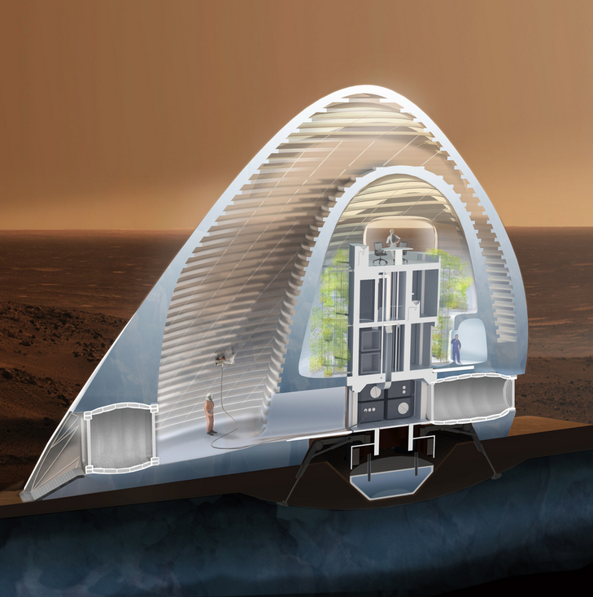
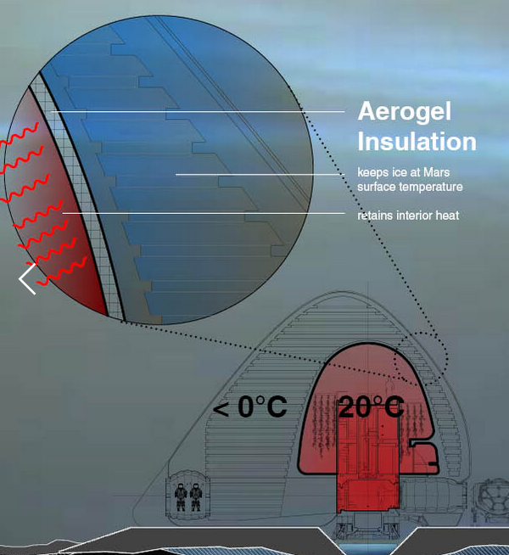
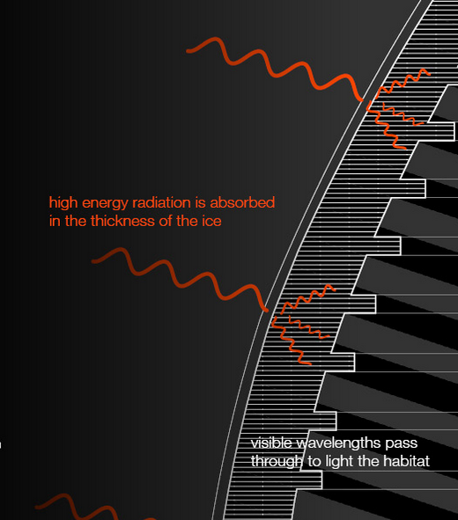
How would a Martian skyline look like?
Future projects: Mars Ice House
The interior volume of ice is printed as a series of excavated or “hollowed-out” spaces to form the walls and divisions of the habitat volume.
Water's absorption spectrum absorbs high energy short wavelength radiation making it an effective radiation shield.
Proposal for the construction of a habitat using a 3D printing technique employing Ice Water for its structure, this is chosen for a number of reasons.
A translucent hydrophobic aerogel layer is printed between the inner ice shell and the inhabited spaces to ensure thermal comfort.
It is a porous substance, 99.8% empty space by volume. It is brought on the lander from Earth, serves an efficient air gap to create the necessary thermal break. The insulating layer enables the inner volume to achieve habitable temperatures without melting the ice structure beyond.
Notes:
Source: http://www.marsicehouse.com/

Slide 25
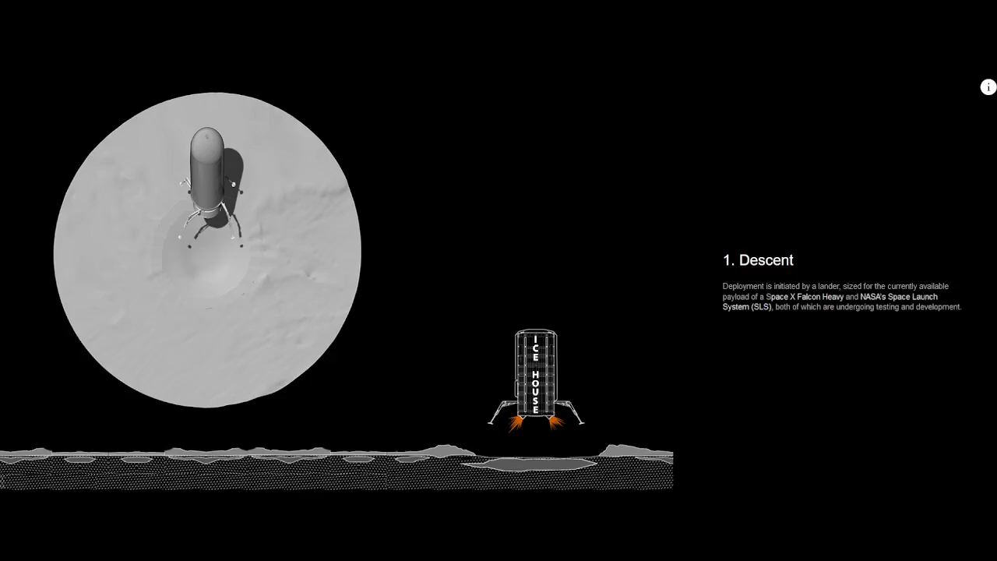
How would a Martian skyline look like?
Future projects: Mars Ice House
Notes:
Source: http://www.marsicehouse.com/ice-on-mars/2015/9/24/water-ice-radiation-shield-light-transmitter

Slide 26
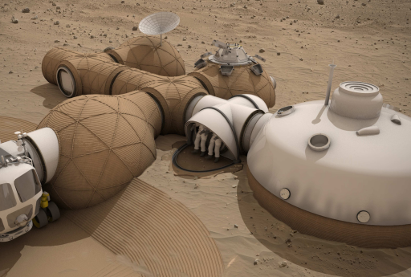
How would a Martian skyline look like?
Future projects: Mars Lava Hive
A modular habitat concept based on a hybrid approach, with structural elements of a central habitat arriving from Earth conventionally, while an additive manufacturing (AM) process is used in situ to expand the central habitat workspace using Martian regolith soil and sand.
Using a proposed novel ‘lava-casting’ construction technique, utilizing recycled spacecraft materials and structures, which represents a Class III ISRU derived structure.
[6]
Notes:
Source: An ISRU-based architecture for Human Habitats on Mars; the 'Lava Hive' concept

Slide 27
Conclusions

Slide 28



Conclusions and further work
Conclusions
The technologies that need to be developed for future Lunar and Martian settlements are feasible but need to be tested further.
There are a number of methods to approach this design problem, and the best option will be a trade-off between these.
ISRU will be required for these type of missions, but it won’t be the only way to acquire materials at first. Transporting materials and technology from Earth will also be essential.
Further work
More Lunar and Martian soil samples should be acquired and studied in order to accurately determine the material properties and to validate the manufacturing methods that have been proposed.

Slide 29
Bibliography
[1] M. Yashar, C. Ciardullo, M. Morris, R. Pailes-Friedman, R. Moses, D. Case, Mars X-House: Design Principles for an Autonomously 3D-Printed ISRU Surface Habitat, (2019) 1–20.
[2] J.A. Happel, Indigenous materials for lunar construction, Appl. Mech. Rev. 46 (1993) 313–325. https://doi.org/10.1115/1.3120360.
[3] J. Liu, H. Li, L. Sun, Z. Guo, J. Harvey, Q. Tang, H. Lu, M. Jia, In-situ resources for infrastructure construction on Mars: A review, Int. J. Transp. Sci. Technol. (2021) 1–16. https://doi.org/10.1016/j.ijtst.2021.02.001.
[4] E.J. Faierson, K. V. Logan, B.K. Stewart, M.P. Hunt, Demonstration of concept for fabrication of lunar physical assets utilizing lunar regolith simulant and a geothermite reaction, Acta Astronaut. 67 (2010) 38–45. https://doi.org/10.1016/j.actaastro.2009.12.006.
[5] N. Kalapodis, G. Kampas, O.J. Ktenidou, A review towards the design of extraterrestrial structures: From regolith to human outposts, Acta Astronaut. 175 (2020) 540–569. https://doi.org/10.1016/j.actaastro.2020.05.038.
[6] A. Cowley, B. Imhof, L. Teeney, R. Waclavicek, F. Spina, A. Canals, J. Schleppi, P. Soriano, An ISRU-Based Architecture for Human Habitats on Mars: the “Lava Hive” Concept, Acta Futur. (2016) 109–119. https://doi.org/10.5281/zenodo.202220.
[7] N. Labeaga-Martínez, M. Sanjurjo-Rivo, J. Díaz-Álvarez, J. Martínez-Frías, Additive manufacturing for a Moon village, Procedia Manuf. 13 (2017) 794–801. https://doi.org/10.1016/j.promfg.2017.09.186.

Slide 30
Bibliography
[8] G. Cesaretti, E. Dini, X. De Kestelier, V. Colla, L. Pambaguian, Building components for an outpost on the Lunar soil by means of a novel 3D printing technology, Acta Astronaut. 93 (2014) 430–450. https://doi.org/10.1016/j.actaastro.2013.07.034.
[9] B. Grundström, Additive manufacturing of lunar regolith simulant using direct ink writing, (2020).
[10] H.A. Toutanji, S. Evans, R.N. Grugel, Performance of lunar sulfur concrete in lunar environments, Constr. Build. Mater. 29 (2012) 444–448. https://doi.org/10.1016/j.conbuildmat.2011.10.041.
[11] Y. Reches, Concrete on Mars: Options, challenges, and solutions for binder-based construction on the Red Planet, Cem. Concr. Compos. 104 (2019) 103349. https://doi.org/10.1016/j.cemconcomp.2019.103349.

Slide 31
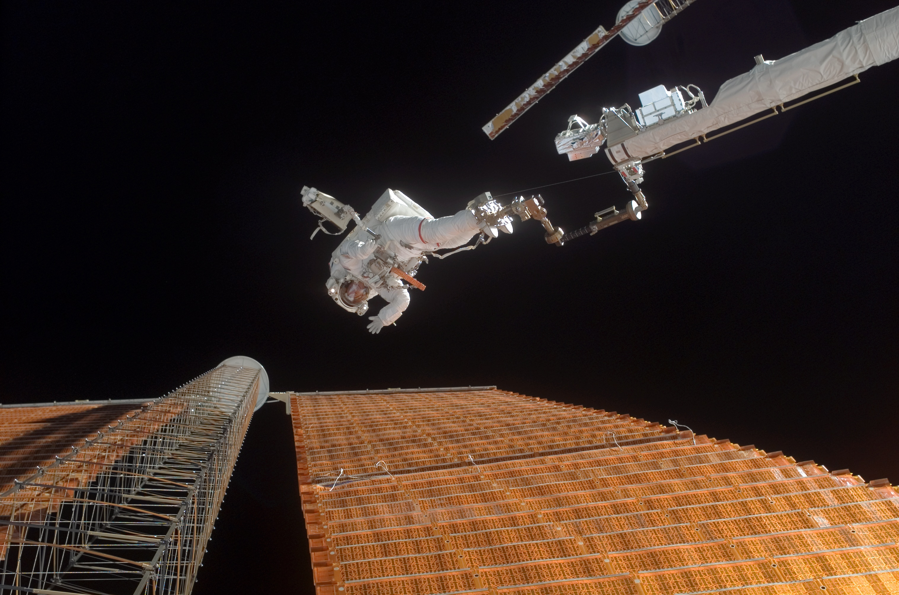
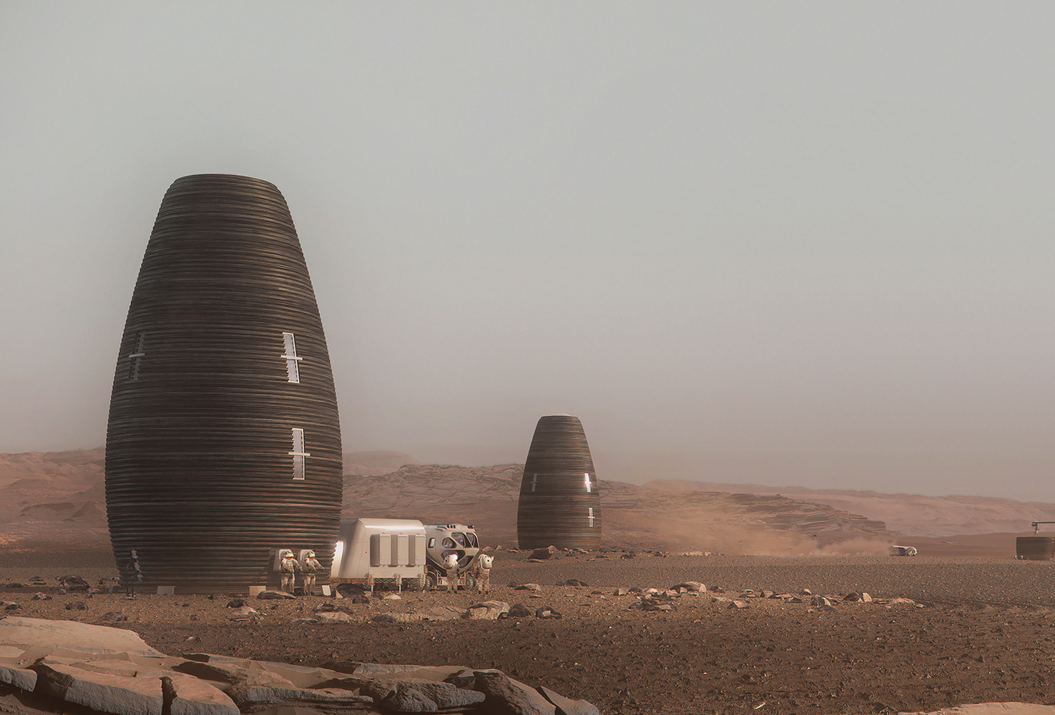
Any Questions?

